Slide 1
SUPERSTORE DATA ANALYSIS
OMIS 673
Under the guidance of Prof. Young Lee
Team - 10
Lakshmi Suma Latha Gandham Z1983150
Prathyusha Chittajallu Z1976210
Eswar Kumar Gangavarapu Z1981618
Jaswanth Chowdary Paladugu Z1977511

Slide 2
AGENDA
About the Dataset
The 3-Minute Story
Big Idea
Visualizations
Interactive Dashboard
Conclusion

Slide 3
ABOUT THE DATASET
The Superstore Dataset
Overview:
This dataset is taken from the Kaggle website: https://www.kaggle.com/datasets/vivek468/superstore-dataset-final
The dataset provides a comprehensive view of sales transactions from the Superstore.
It includes essential information such as order details, customer information, product details, and financial metrics.
Key Variables:
Order Date and Ship Date: Insights into order processing and shipping efficiency.
Ship Mode: Understanding customer preferences in shipping.
Customer Segments: Segmentation of customers based on their characteristics.
Geographic Information: Helps in analyzing regional trends and preferences.
Product Details: Categorization of products and their performance metrics.

Slide 4
The 3-Minute Story
In the heart of the United States there stood a Superstore, a beacon of commerce and community. Inside within its walls, they kept track of the data from 2014 to 2017, painting a vivid picture of sales and profits across the land.
The Intellects delved into key variables such as Order Date, Ship Date, Customer Segments, Ship Mode, Geographic Information, and Product Details, shaping the destiny of this enterprise. These pillars serve as the foundation upon which we build our narrative, unraveling patterns, trends, and insights that illuminate the journey of this superstore chain over the years.
Utilizing various analytics techniques, we've meticulously crafted a series of visualizations and an interactive dashboard that serve as windows into the soul of this dataset. Through this tool, we aim to not only showcase the story hidden within the numbers but also empower decision-makers with actionable insights.
Throughout this presentation, we'll explore various facets of the data, ranging from profit analysis across customer segments to key performance indicators (KPIs) shedding light on sales and profitability trends. Moreover, we'll navigate through geographics, and delve into various product categories and their subcategories.
In essence, this presentation is not merely about numbers; it's about understanding the language of data to unveil opportunities, mitigate risks, and ultimately drive strategic decision-making within the retail domain. So, buckle up as we embark on this analytical odyssey, where every chart tells a story, and every insight paves the way for informed action.

Slide 5
Big Idea
In the era of data-driven decision-making, unlocking the power of retail analytics offers an unparalleled opportunity to transform mere transactions into strategic insights. Through the lens of advanced analytics and visualization, we illuminate the path to profitability and sales where the home office shows us the least and the customer segment shows us the highest unveiling hidden patterns of profitability, untapped potential, and actionable intelligence. Our mission is to empower retailers with the foresight to anticipate trends, optimize operations, and elevate the customer experience.

Slide 6
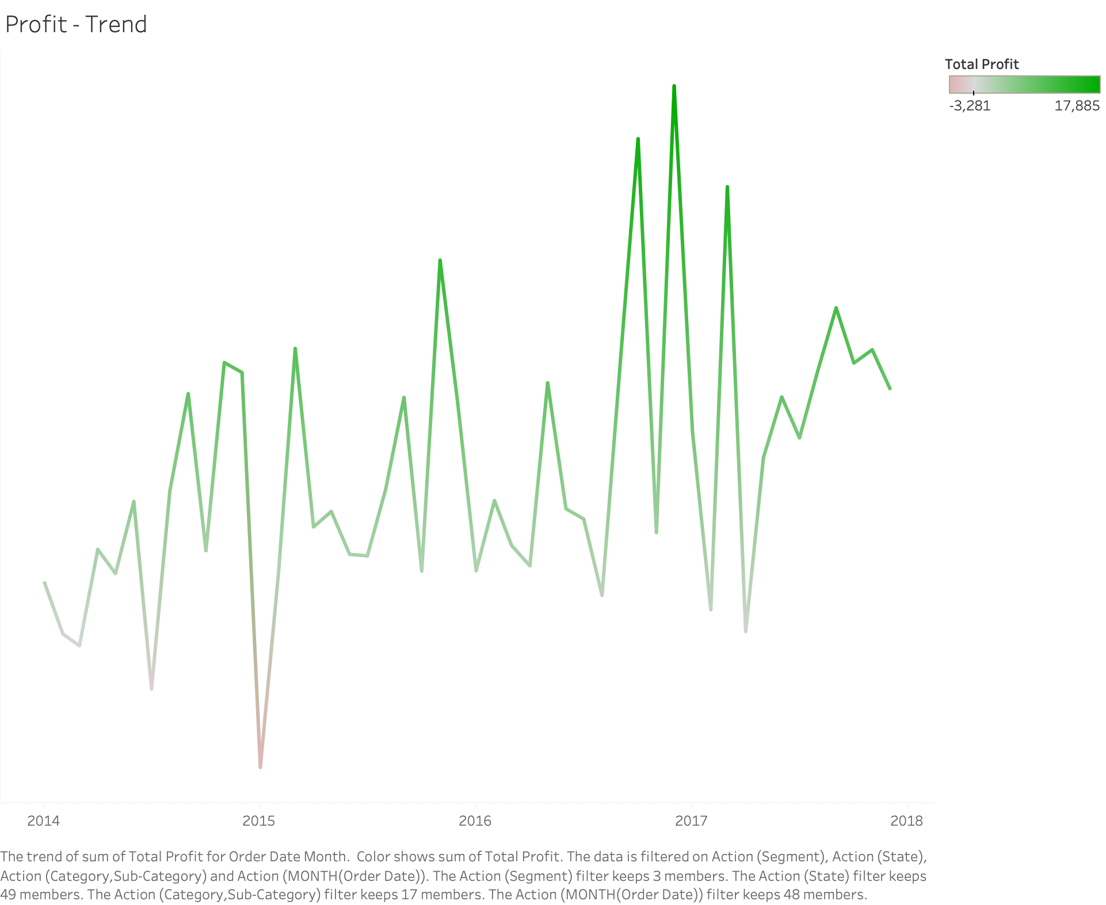
Chart #1: Profit Trend

Slide 7
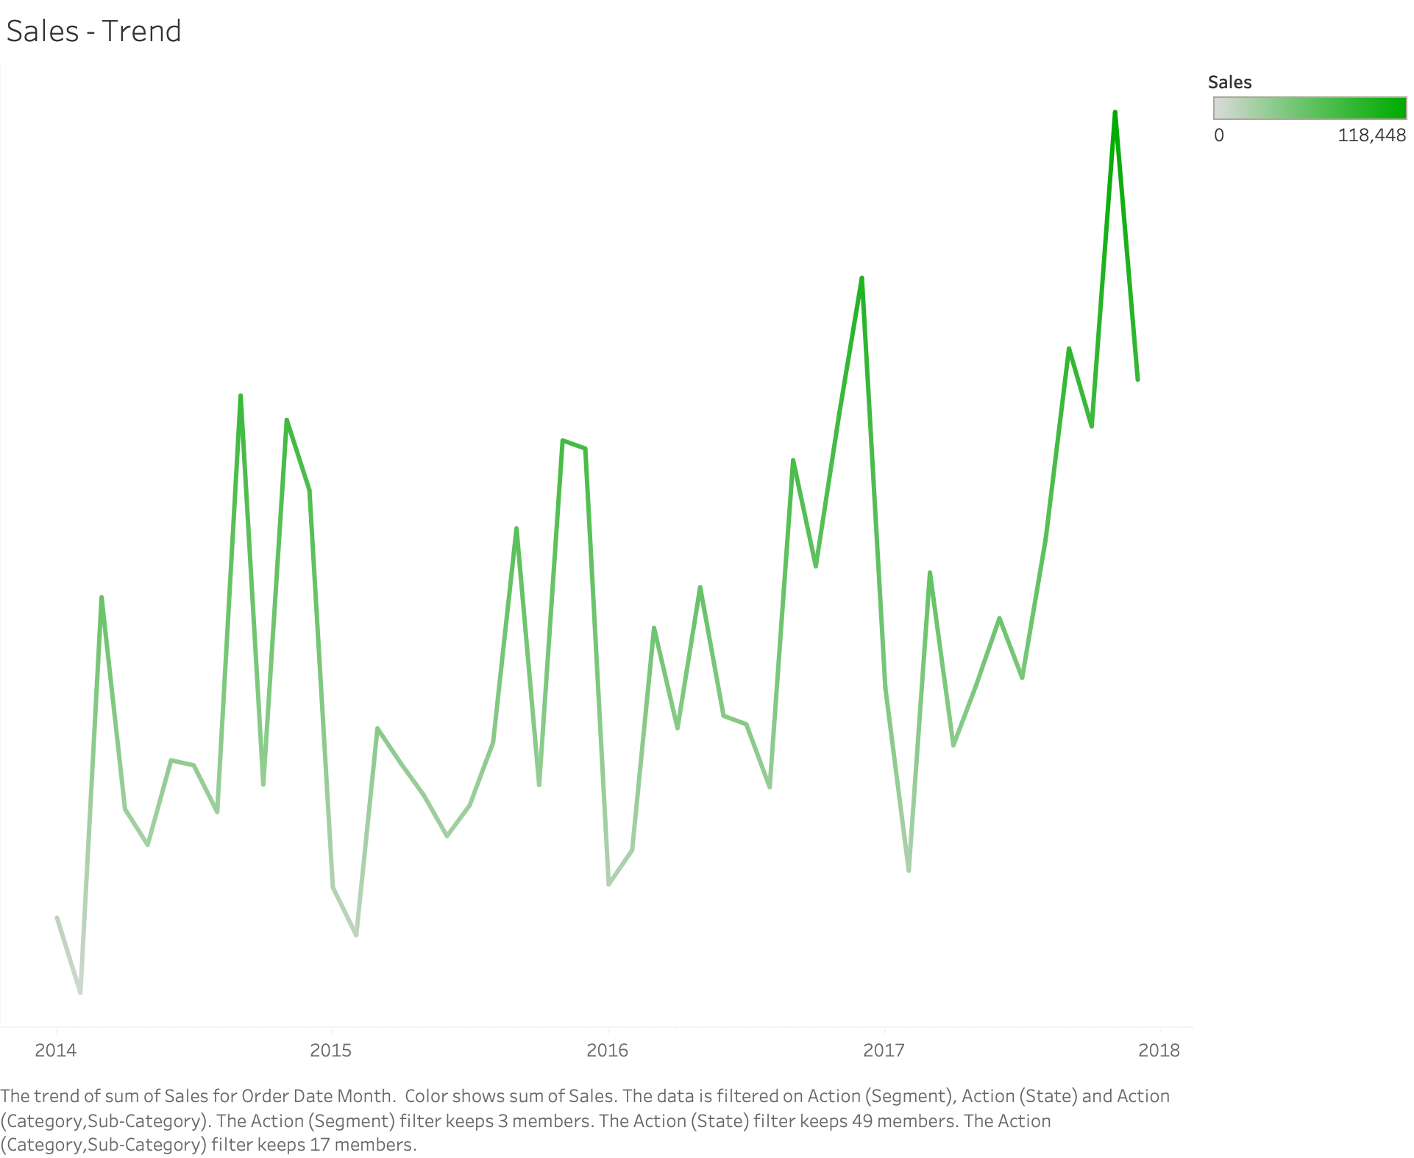
Chart #2: Sales Trend

Slide 8
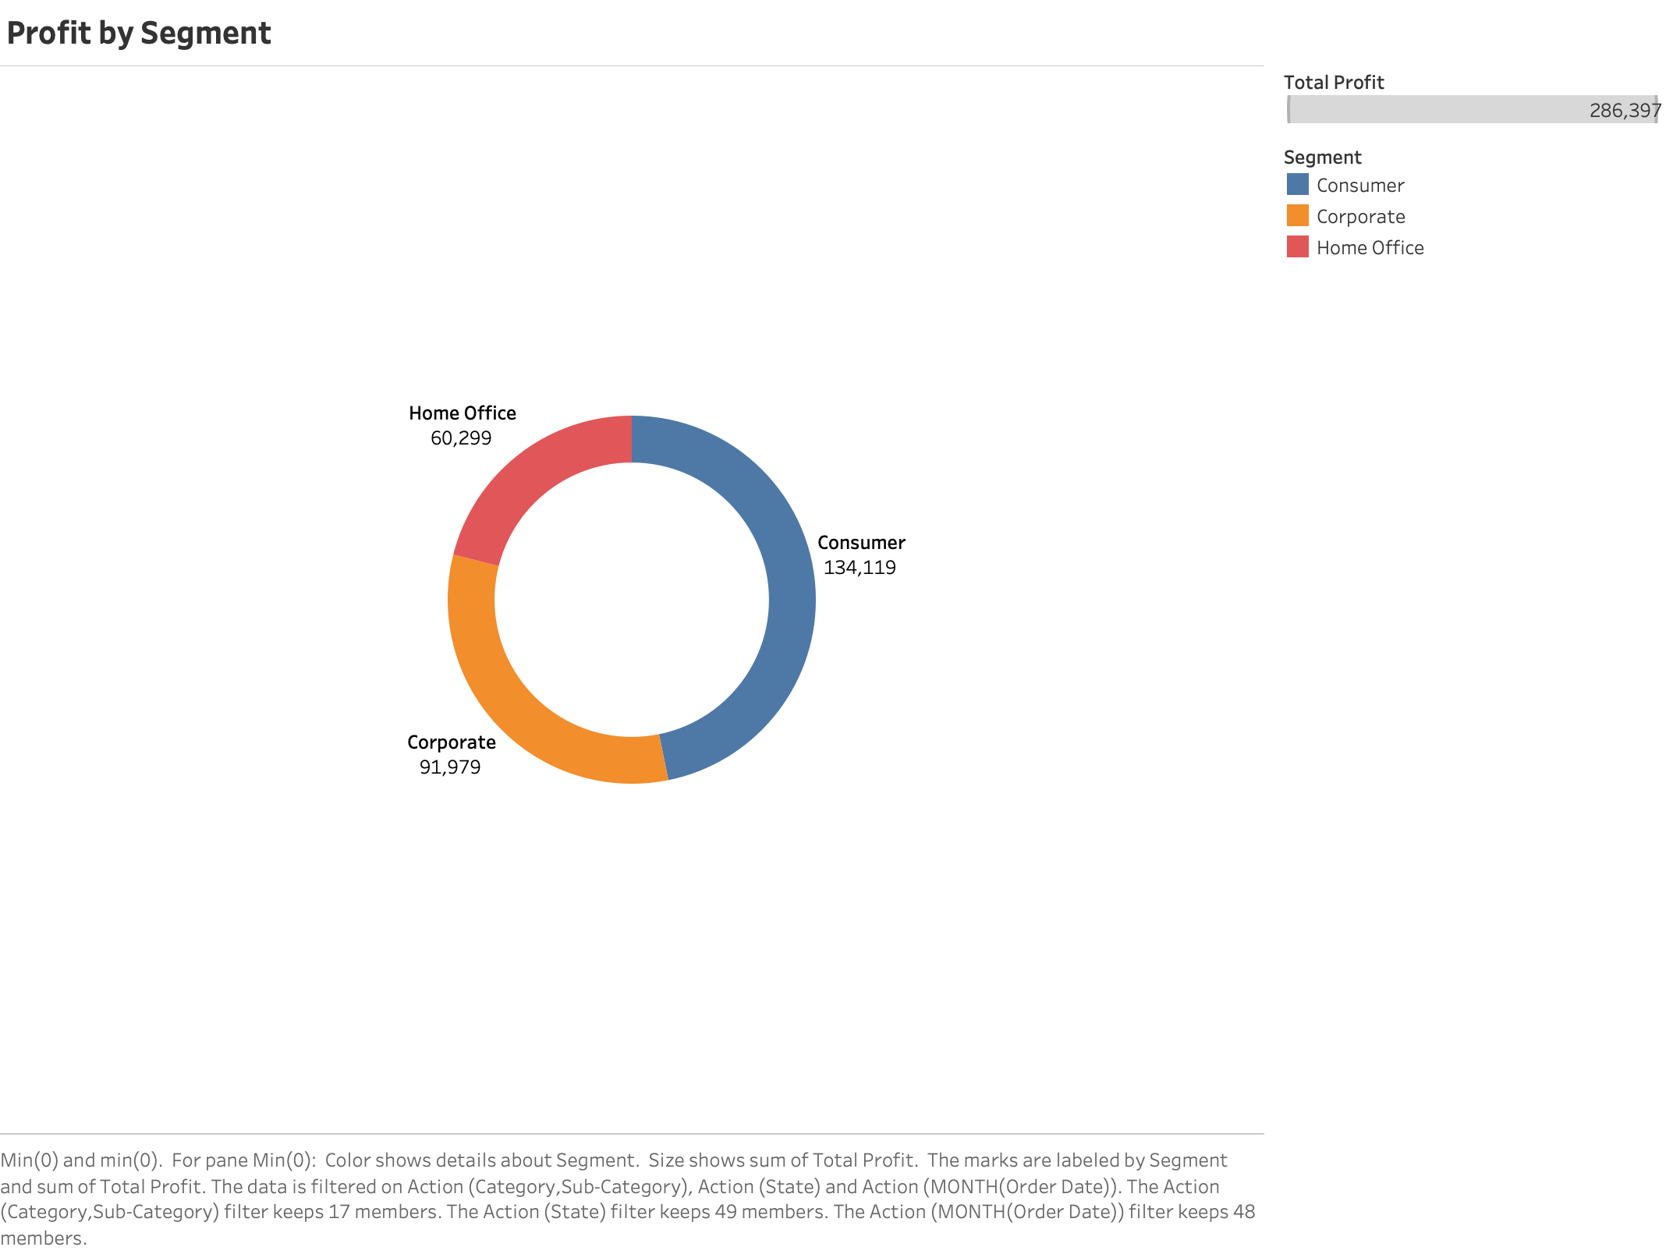
Chart #3:Profit by Segment

Slide 9
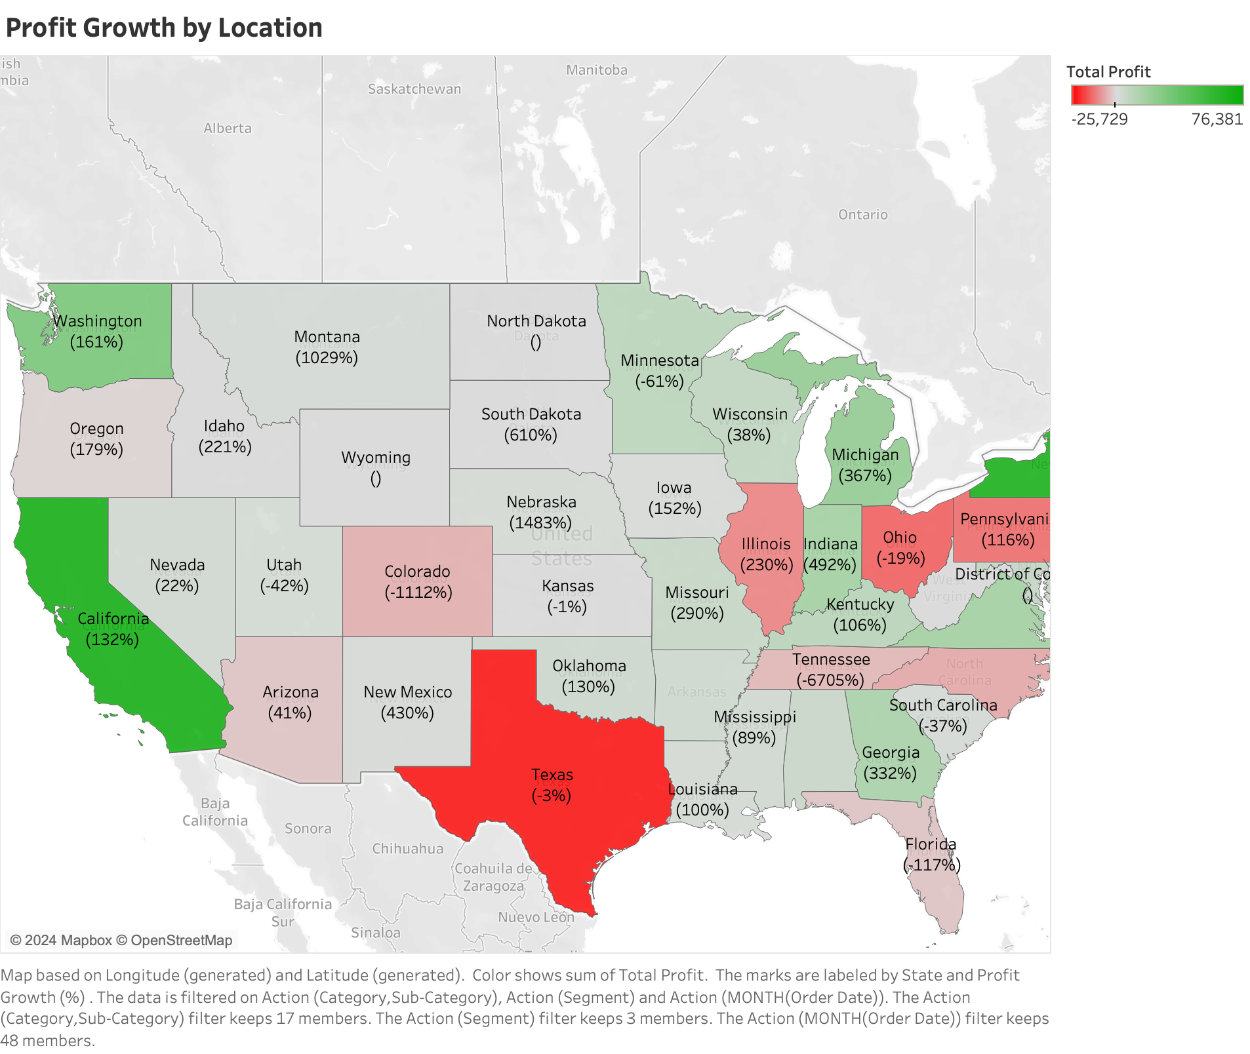
Chart #4:Profit Growth by Location

Slide 10
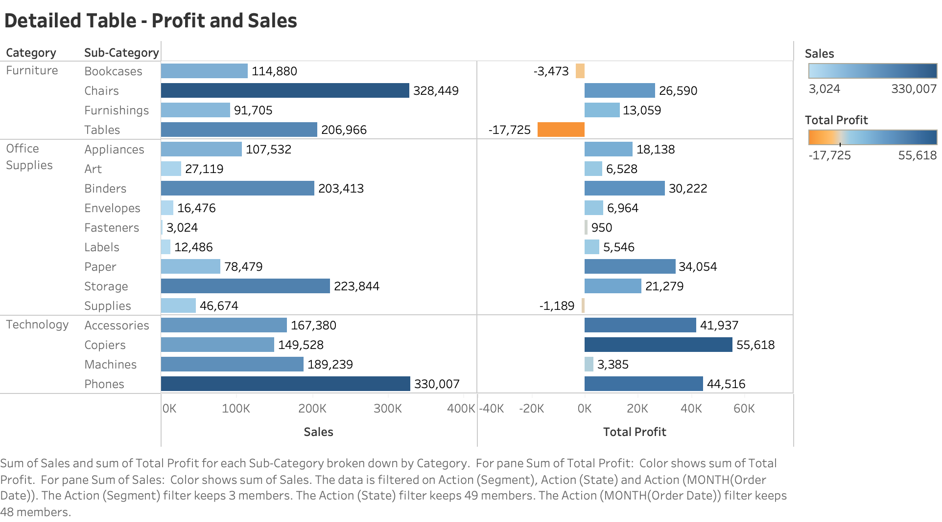
Chart #5: Detailed Table - Profit and Sales

Slide 11
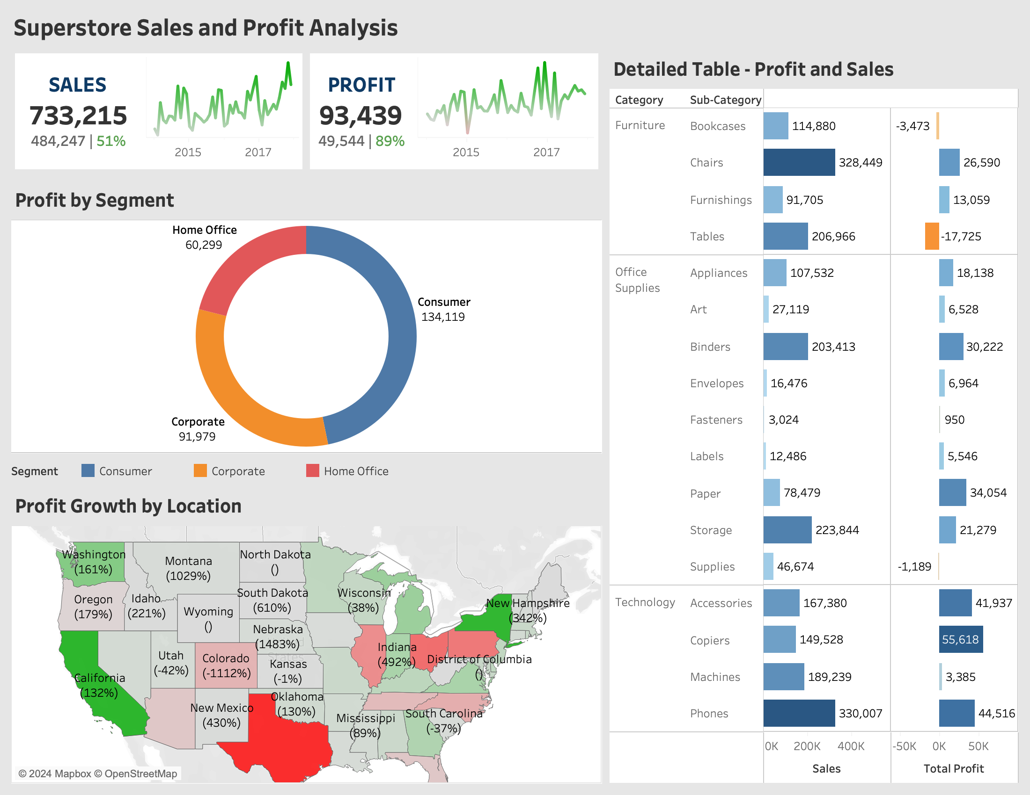
Interactive Dashboard:

Slide 12
Conclusion
In concluding our journey through the superstore dataset, we recognize the transformative impact of visualizations. From profit analysis to KPI elucidation, each chart and graph has empowered stakeholders with actionable insights. Beyond analytics, visualizations have simplified complexity, fostering clarity and enabling informed decision-making at every level. As we conclude, let us embrace the power of visual analytics to drive innovation and propel the retail industry into a new era of prosperity. Gratitude to all for your engagement and dedication. May the visualizations unveiled today guide us toward a future where data reigns supreme in shaping retail excellence.

Slide 13

Any Questions?

Slide 14


